Slide 1
HUB – SATS Information
08 / 11 / 2019

Slide 2
Overview
Cyber Security

Slide 3





High Level Communications Schema – TIER 1 / TIER 2
SORT_RQST / SORT_RSLT
TOE
T1
T2
T3
T4
Data Protection
T5
Server TIER1
T9
T8
T7
T6
Server TIER2
GTW TIER2
MQ CLIENT
MQ CLIENT
SORT_INST / SORT_ACK

Slide 4

MQ – Data fields from sniffer
Field Name | Description | Symbol | Note
Frame_Time | Timestamp di cattura del pacchetto da parte dello sniffer.
Frame_Time_P | Timestamp di cattura dell pacchetto precedente (stesso VID) da parte dello sniffer.
Frame_Time_DIFF_mill | Differenza con millesimi tra Frame_Time e Frame_Time_Precedente
HDEVTM | Informazione di Timestamp inserito nel pacchetto MQ dal server.
HDEVTM_P | Informazione di Timestamp del messaggio precedente (con stesso VID) inserito nel pacchetto MQ dal server.
HDEVTM_P_mill | Differenza con millesimi tra HDEVTM e HDEVTM_Precedente
T2 | T2 segment calculation time for T2 (Frame_Time – HDEVTM) |  | [2019-11-08: Actually T2 don’t use millisecond, the metric is not usefull]
T6T7 | Segment calculation time for T6 and T7 (Frame_Time – HDEVTM) |  | [2019-11-08: Actually T2 don’t use millisecond, the metric is not usefull]

Slide 5
MQ – Data fields from sniffer
Field Name | Description | Symbol | Note
COW | MQ Capacity «One Way» |  | Described in next slide

Slide 6
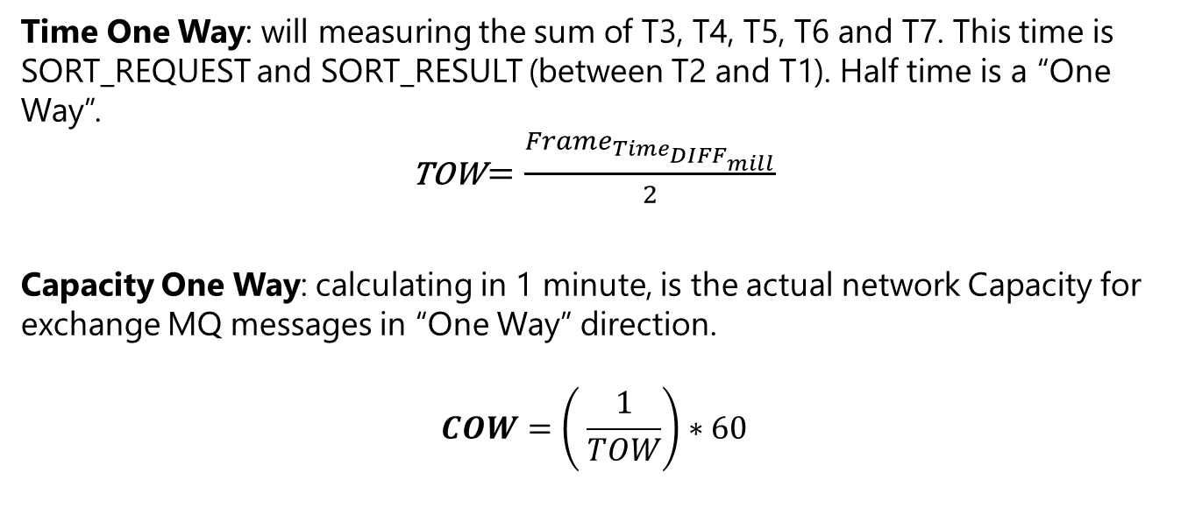
TOW and COW
_ _
((___))
[ - - ]
\ /
(' ')
(U)
Time One Way: will measuring the sum of T3, T4, T5, T6 and T7. This time is SORT_REQUEST and SORT_RESULT (between T2 and T1). Half time is a “One Way”.
TOW $=\frac{Frame_{Time_{DIFF_{mill}}}}{2}$
Capacity One Way: calculating in 1 minute, is the actual network Capacity for exchange MQ messages in “One Way” direction.
$$COW=\left( \frac{1}{TOW}\right)∗60$$

Slide 7
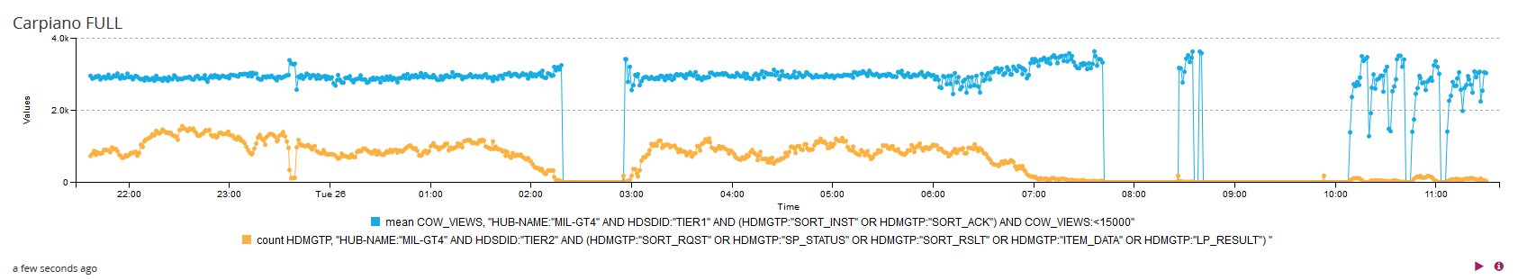
COW VIEWS
_ _
((___))
[ - - ]
\ /
(' ')
(U)
COW VIEWS QUERY FOR GRAILOG DASHBOARD (Use two difference chart and arise in one each other):
Field for chart:
1st query: Field": "COW_VIEWS", "statistical_function": "means"
2nd query: Field": "HDMGTP", "statistical_function": "count"
Query:
HUB-NAME:"HUB-NAME" AND HDSDID:"TIER1" AND (HDMGTP:"SORT_INST" OR HDMGTP:"SORT_ACK") AND COW_VIEWS:<15000
HUB-NAME:"HUB-NAME" AND HDSDID:"TIER2" AND (HDMGTP:"SORT_RQST" OR HDMGTP:"SP_STATUS" OR HDMGTP:"SORT_RSLT" OR HDMGTP:"ITEM_DATA" OR HDMGTP:"LP_RESULT")

Slide 8
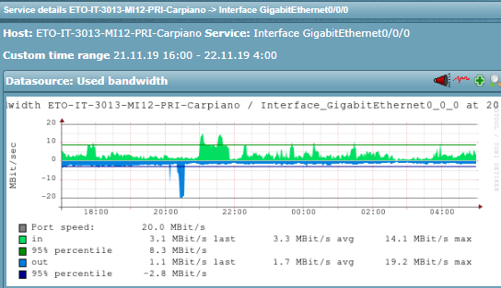
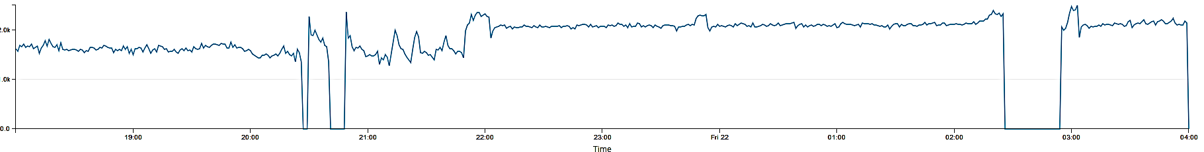
COW VIEWS Vs LAN Bandwidth – Real issue
_ _
((___))
[ - - ]
\ /
(' ')
(U)
COW Chart
Bandwidth IN
Bandwidth OUT
Bandwidth overload caused a MQ channel interruption
During sorter operation, due to single thread MQ client (T2), a tail due to saturation has been created with no messages send to T1

Slide 9
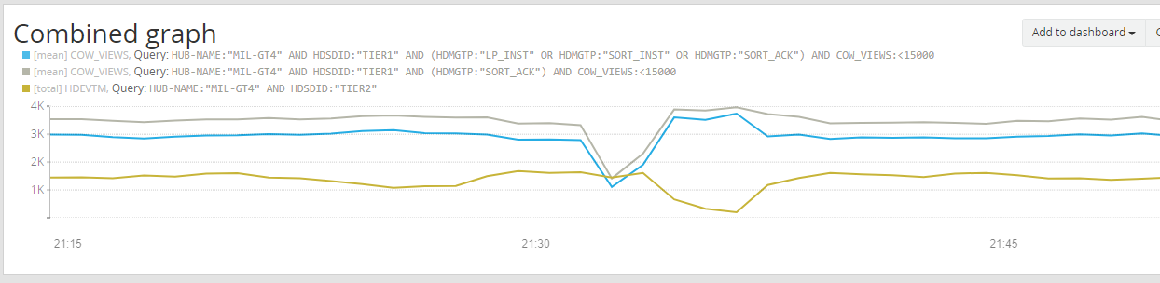
COW VIEWS Vs LAN Bandwidth – Real issue
_ _
((___))
[ - - ]
\ /
(' ')
(U)
COW based only on SORT_ACK from T1
MQ Channel overload
COW based on means of SORT_ACK SORT_INST and LP_DATA from T1
All MQ message exchanged by T2 to T1

